Slide 1
Diverse and Proportional Size-l Object Summaries for Keyword Search SIGMOD 2015
GEORGIOS J. FAKAS
Department of Computer Science and Engineering
Hong Kong University of Science and Technology
Hong Kong
ZHI CAI
College of Computer Science
Beijing University of Technology
Beijing, China
NIKOS MAMOULIS
Department of Computer Science
The University of Hong Kong
Hong Kong

Slide 2


Hong Kong University of Science and Technology

Slide 3
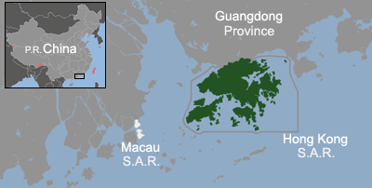
Hong Kong

Slide 4

Hong Kong

Slide 5

Hong Kong

Slide 6
Outline
1. Motivation
2. Background & Related work
3. Diverse & Proportional Size-l
4. Size-l & Prelim-l OSs
5. Evaluation Results
6. Conclusion & Future Work

Slide 7
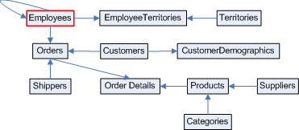
1.1 Object Summaries
Relational Databases are everywhere: Web, Desktops etc.
Social graphs are also everywhere!
Difficult to retrieve information about a Data Subject (DS) unless you know very well:
SQL and
Schema details etc.
There is a need for keyword search facilities analogous to Web
Select *
From Employees, Orders, Shippers
Where Employees.ID=Orders.ID
AND Orders.Shipper=Shippers.ID
AND Name=“Leverling”

Slide 8
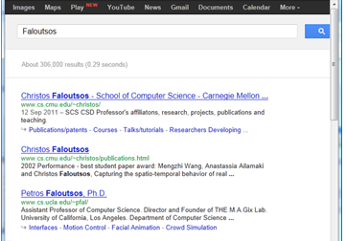
1.1 Object Summaries
Query Search: Faloutsos
Web Search Result: ranked set of links
and snippets

Slide 9

1.1 Object Summaries
Query Search: Faloutsos
Web Search Result: ranked set of links
and snippets

Slide 10
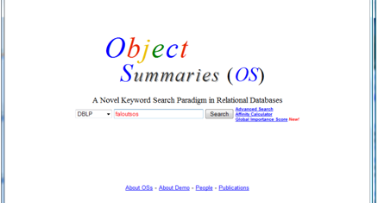
1.1 Object Summaries
Query Search: Faloutsos
Web Search Result: ranked set of links
and snippets
Query Search: Faloutsos
OS Result: set of OSs and size-l OSs.

Slide 11
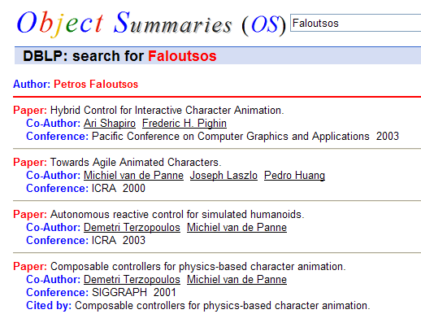
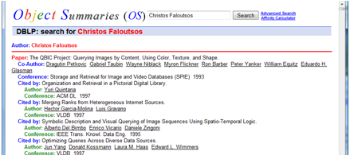
1.1 Object Summaries
Query Search: Faloutsos
Web Search Result: ranked set of links
and snippets
Query Search: Faloutsos
OS Result: set of OSs and size-l OSs.

Slide 12
Outline
1. Motivation
2. Background & Related work
3. Diverse & Proportional Size-l
4. Size-l & Prelim-l OSs
5. Evaluation Results
6. Conclusion & Future Work

Slide 13
2.1 Object Summaries
OS Generation - Methodology
t^{DS} a central tuple containing the Kw; tuples around t^{DS} contain additional information about the Data Subject.
R^{DS} the corresponding central Relation; similarly Relations around contain additional information.
[Fakas, DKE, 2011]
Our solutions are based on the assumption that each database has central relations (denoted as RDS) that represent the DS’s. E.g
Northwind RDS = { REmployees, RCustomers }
Relations linked around RDSs include additional information about the DS

Slide 14
2.1 Object Summaries
OS Generation - Methodology
t^{DS} a central tuple containing the Kw; tuples around t^{DS} contain additional information about the Data Subject.
R^{DS} the corresponding central Relation; similarly Relations around contain additional information.
[Fakas, DKE, 2011]

Slide 15
2.1 Object Summaries
OS Generation - Methodology
t^{DS} a central tuple containing the Kw; tuples around t^{DS} contain additional information about the Data Subject.
R^{DS} the corresponding central Relation; similarly Relations around contain additional information.
[Fakas, DKE, 2011]

Slide 16
2.1 Object Summaries
OS Generation - Methodology

Slide 17
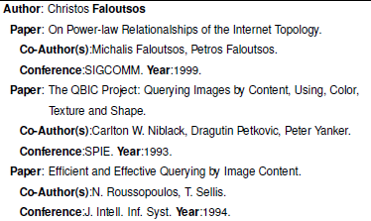
2.2 Size-l Object Summaries 1. Definition
Properties:
Synoptic (small l)
Stand-alone and Meaningful (connected tree)
Include the most important information about the particular DS (score for each node)
Importance of a Size-l OS S
Im(S)=Σ(li(n_{i}))
Local Importance of a Tuple t_{i}
li(n_{i})= gi(n_{i})*Af(n_{i})
[Fakas et al., PVLDB, 2011]
Notes:
17

Slide 18
2.2 Size-l Object Summaries 2. Problems!
Query:
Author = Michalis Faloutsos and l = 15
Author: Michalis Faloutsos
Paper: On Power-law Relationships of the Internet Topology.
Co-author: Christos Faloutsos
Paper: Power laws and the AS-level internet topology.
Co-author: Christos Faloutsos
Paper: Information Survival Threshold in Sensor and P2P Networks.
Co-author: Christos Faloutsos
Paper: BGP-lens: patterns and anomalies in internet routing updates.
Co-author: Christos Faloutsos
Paper: Competing memes propagation on networks: a case study of…
Co-author: Christos Faloutsos
Paper: Threshold Conditions for Arbitrary Cascade Models on Arbitrary...
Co-author: Christos Faloutsos
Paper: A simple conceptual model for the Internet topology.
Co-author: Christos Faloutsos
Christos Faloutsos appears 7 times!

Slide 19
2.3 Motivation Diversity and Proportionality
Query: Michalis Faloutsos
OS: Co-Authors and their li and frequency

Slide 20
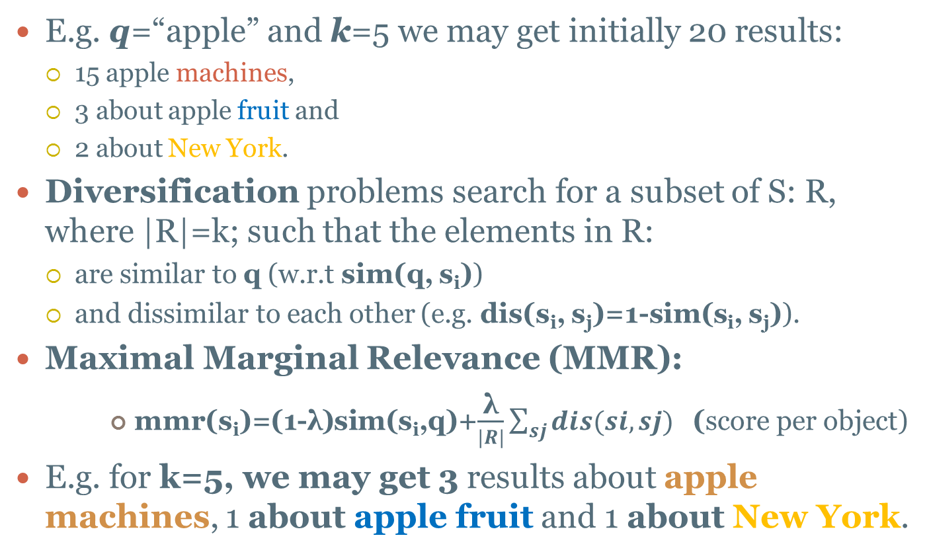
2.4 Diversity
E.g. q=“apple” and k=5 we may get initially 20 results:
15 apple machines,
3 about apple fruit and
2 about New York.
Diversification problems search for a subset of S: R, where |R|=k; such that the elements in R:
are similar to q (w.r.t sim(q, s_{i}))
and dissimilar to each other (e.g. dis(s_{i}, s_{j})=1-sim(s_{i}, s_{j})).
Maximal Marginal Relevance (MMR):
mmr(s_{i})=(1-λ)sim(s_{i},q)+$\frac{\text{λ}}{|R|}\sum_{sj}{dis(si,sj)}$ (score per object)
E.g. for k=5, we may get 3 results about apple machines, 1 about apple fruit and 1 about New York.

Slide 21
2.5 Proportionality
E.g. q=“apple” and k=5 we may get initially 20 results:
15 apple machines ,
3 about apple fruit and
2 about New York.
where sim(s_{i},q) for machines is very weak in comparison to fruit and NY
Then, we may end up with 3 fruits, 2 NY and 0 machine results.
We observe that machines are not presented;
We suggest that since they exist 15 out 20
they should be proportionally included!
Proportionality facilitates some diversity

Slide 22
Outline
1. Motivation
2. Background & Related work
3. Diverse & Proportional Size-l
4. Size-l & Prelim-l OSs
5. Evaluation Results
6. Conclusion & Future Work

Slide 23
3.1 Diverse size-l (DSize-l) OS
Diversity Properties:
Christos Faloutsos
appears only twice;
facilitating the appearance
of other interesting
information

Slide 24
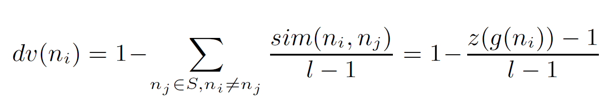
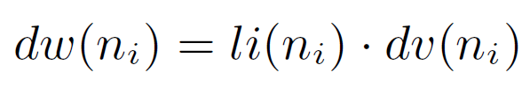
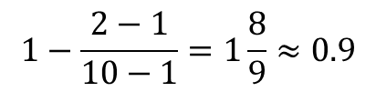
3.1 Diverse size-l (DSize-l) OS
Formulas:
Co-authors in OS of M. Faloutsos, z=2, l=10
Name | li | fr | dv[1] | dw[1] | dv[2] | dw[2]
S.Krishnamurthy | 0.6 | 37 | 1.0 | 0.6 | 0.9 | 0.5
C.Faloutsos | 1.8 | 12 | 1.0 | 1.8 | 0.9 | 1.6
$$1−\frac{2−1}{10−1}=1\frac{8}{9}≈0.9$$
e.g. C. Faloutsos (z=2, l=10):

Slide 25
3.2 Proportional size-l (PSize-l) OS
Properties:
Very Frequent authors with
smaller li also appear
Proportionality
At the same time diversity!!

Slide 26
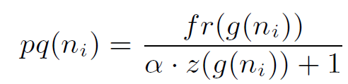
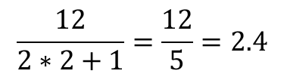
3.2 Proportional size-l (PSize-l) OS
Formulas:
pw(n_{i})=li(n_{i})*pq(n_{i})
Co-authors in OS of M. Faloutsos, α=2, z=2
Name | li | fr | pq[1] | pw[1] | pq[2] | pw[2]
S.Krishnamurthy | 0.6 | 37 | 12.3 | 7.4 | 7.4 | 4.4
C.Faloutsos | 1.8 | 12 | 4.0 | 7.2 | 2.4 | 4.3
$$\frac{12}{2∗2+1}=\frac{12}{5}=2.4$$
e.g. C. Faloutsos (z=2):

Slide 27
Outline
1. Motivation
2. Related work
3. Diverse & Proportional OSs
4. Size-l & Prelim-l OSs
5. Evaluation Results
6. Conclusion & Future Work

Slide 28
4.1 LASP Algorithm Largest Averaged Score Path
Initial OS
The Algorithm iteratively selects and adds to the size-l the path p_{i} of nodes with the largest AP
Time:
O(nl*log(n)).

Slide 29
4.1 LASP Algorithm Largest Averaged Score Path
First update
The Algorithm iteratively selects and adds to the size-l the path p_{i} of nodes with the largest AP
Time:
O(nl*log(n)).

Slide 30
4.1 LASP Algorithm Largest Averaged Score Path
Final update
The Algorithm iteratively selects and adds to the size-l the path p_{i} of nodes with the largest AP
Time:
O(nl*log(n)).

Slide 31
4.2 2-LASP Algorithm Pairs(2)-LASP Algorithm
Initial OS
First update
We take the average between the current node and the parent instead of the whole path from the current node to the root.

Slide 32
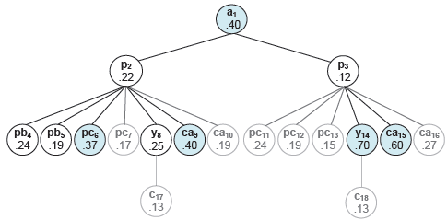
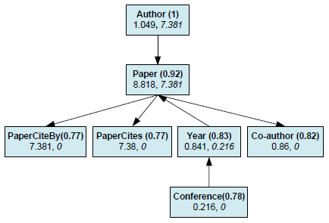
4.3 Prelim-l OS Prelim-l OS
An economical approach is to produce initially a preliminary partial OS with size j (l≤j ≤|OS|).
It includes at least the l unique nodes of the complete OS with the largest w(.) score

Slide 33
Outline
1. Motivation
2. Background & Related work
3. Diverse & Proportional OSs
4. Size-l & Prelim-l OSs
5. Evaluation Results
6. Conclusion & Future Work

Slide 34
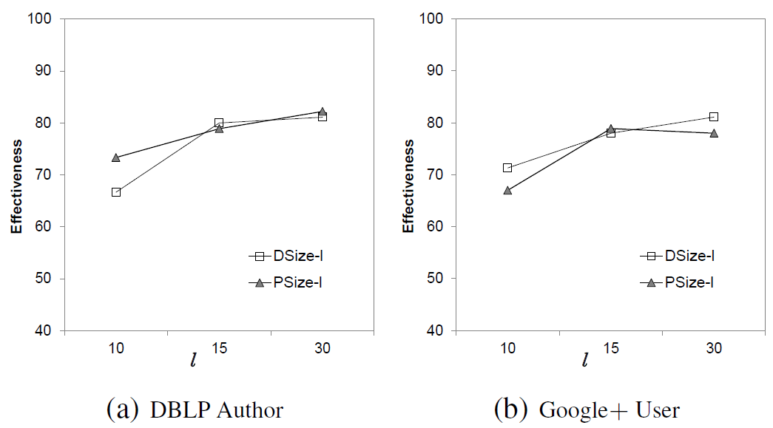
5. Experimental Evaluation Effectiveness
We asked the Authors to suggest their size-l OS
Precision=Recall

Slide 35
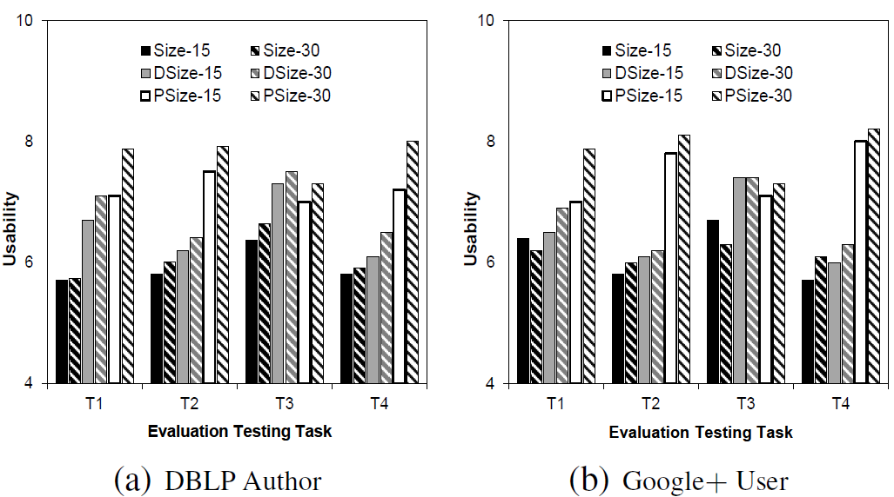
5. Experimental Evaluation Usability Testing
Task 2: the two most frequent co-authors
Task 3: the two most important co-authors

Slide 36
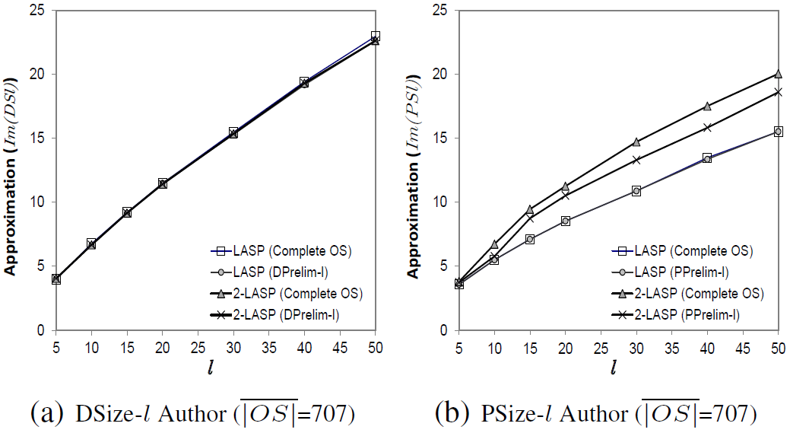
5. Experimental Evaluation Approximation quality
Almost 100% approximation quality on DSize-l

Slide 37
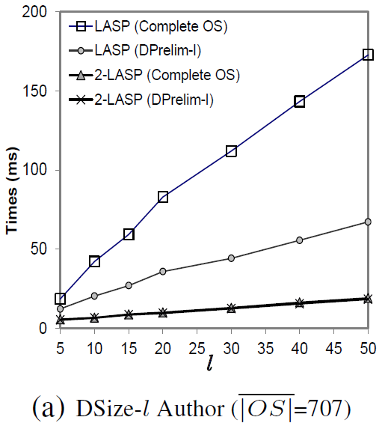
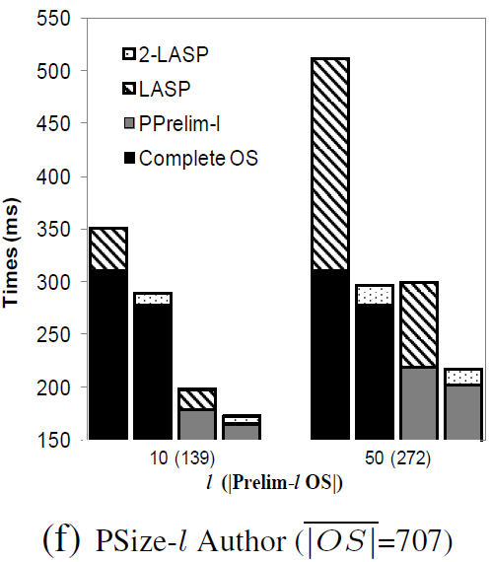
5. Experimental Evaluation Efficiency
Prelim-l faster.
Also 2-LASP faster on both OS and size-l

Slide 38
Outline
1. Motivation
2. Background & Related work
3. Diverse & Proportional Size-l
4. Size-l & Prelim-l OSs
5. Evaluation Results
6. Conclusion & Future Work

Slide 39
6.1 Conclusion & Future Work Contributions
The formal definition of diverse and proportional size-l OSs
The efficient generation of size-l OSs
Optimal and Greedy Algorithms
Applications: Google, Google Desktop, DBMS, etc.
Notes:
39

Slide 40
6.2 Conclusion & Future Work Plans for Future Work
Investigation of inter-diversity and inter-proportionality among a set of query results
e.g. if authors have common paper we can show details of a paper only once
We can diversify OS results, considering similarity of constituent nodes
Combined size-l and top-k ranking of OSs
Notes:
40

Slide 41
Diverse and Proportional Size-l Object Summaries for Keyword Search
Thank you
Questions!

Slide 42
2.1 Object Summaries
OS Generation - Methodology
G^{DS}

Slide 43
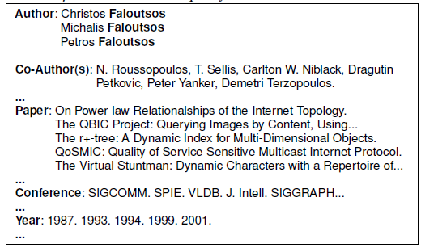
2. Related work
Keyword Search Paradigms
Paper: Efficient similarity….
Author: Agrawal
Author:
Faloutsos
R-KwS
{Agrawal, Faloutsos}
Author: Christos Faloutsos
Précis
{Faloutsos}
Author: Michalis Faloutsos
Précis [Koutrika et al, ICDE, 2006]
Other work:
Streams [Markowetz et al, TODS, 2009]
Top-k, IR Ranking [Hristidis et al, VLDB 2003]
R-KwS
{Faloutsos}
DISCOVER, BANKS [Christidis, 2002]

Slide 44
Ranking
IR-Style techniques, which weight the amount of times keywords (terms) appear in results. However, such techniques miss tuples that are related to the keywords, but they do not contain them.
e.g. for “Faloutsos”, tuples in relation Papers also have importance although they do not include the “Faloutsos” keyword.
Tuple’s Importance, which weights the authority flow through relationships, e.g. ObjectRank, ValueRank, PageRank, XRANK etc.
We use ObjectRank and ValueRank to calculate our Global Importance for each tuple in the database

Slide 45
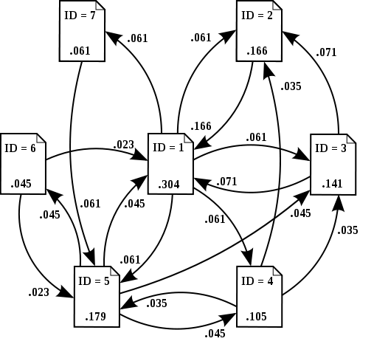
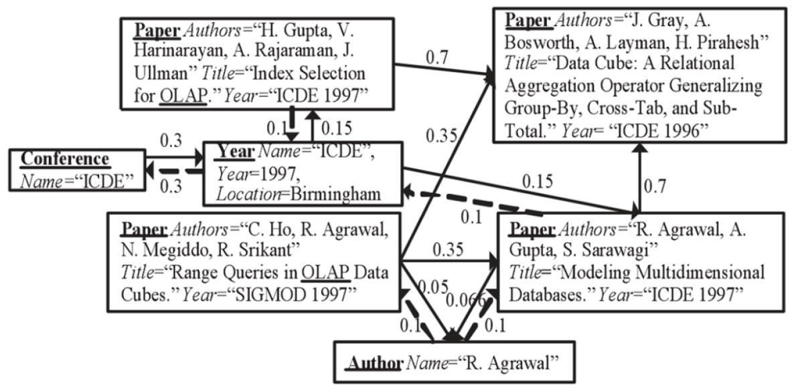
Ranking
How PageRank Works (wikipedia)

Slide 46
2.1 Object Summaries
GDS and Affinity
Metrics:
Distance,
Data and Schema graph Connectivity (Co_{i})
Data-graph Connectivity:
Relative Cardinality (RC_{i}→_{j}), i.e. the average number of tuples of R_{i} that are connected with each tuple from R_{j}
[Fakas, DKE, 2011]
Notes:
46

Slide 47
2.3 Motivation Diversity and Proportionality
Query:
Author = Michalis Faloutsos and Size-l = 15
Author: Michalis Faloutsos
Paper: On Power-law Relationships of the Internet Topology.
Co-author: Christos Faloutsos
Conference: SIGCOMM
Year: 1999
Paper: Information Survival Threshold in Sensor and P2P Networks.
Co-author: Samuel Madden
Conference: MILCOM
Paper: Reducing Large Internet Topologies for Faster Simulations.
Co-author: Srikanth V. Krishnamurthy
Co-author: Jun-Hong Cui
…
Solution:
Diversity and Proportionality!

Slide 48
4.3 Prelim-l OS Prelim-l OS
top-lPQ: A priority queue of size l with the current largest values of tuples extracted from the database.
largest-l: the smallest value of top-lPQ or 0 if |top-lPQ|<l.
Index per G^{DS} Relation:
max(R_{i}): maximum value of local Importance of R_{i.}
mmax(R_{i}): maximum li of all R_{i}’s descendants nodes (0 if R_{i} is a leaf node on the G^{DS} since there are no descendants).
Index per n^{DS} node:
max(n^{DS}): maximum li for all nodes in OS (excluding root).
mw(n^{DS}): maximum w[1] of any node in OS (excluding root).
mFr(n^{DS}): maximum frequency of any node in OS.

Slide 49
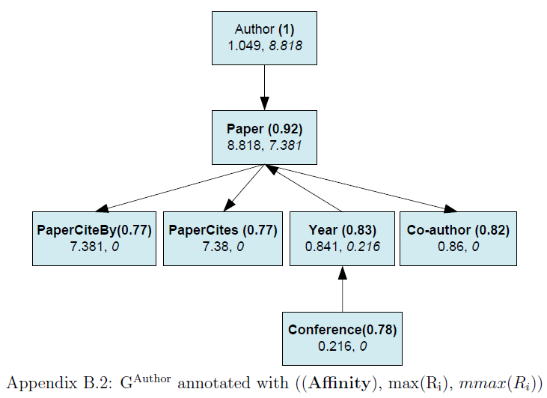
4.3 Prelim-l OS Prelim-l OS
l=5

Slide 50
4.3 Prelim-l OS Prelim-l OS
Avoid Condition 2:
Limiting up to l tuples extractions from fruitful-l relation
Avoid Condition 1:
Avoiding Fruitless path on G^{DS}
e.g. largest-l=0.9
e.g. largest-l=0.9
?
?
Avoid Condition 3:
when UBFr(R_{i})>1, it is possible that we extracted nodes which have already been added.
HFr[g(n_{i})].fr > 1
&&
w(n_{i}) < largest-l
?

